Slide 1
Identification and Management of Vertebral Compression Fractures
By: Christopher Hemmer, NP
Vice President of Piper Spine Care
Adjunct Associate Professor UMSL
Adjunct clinical faculty Saint Louis University

Slide 2
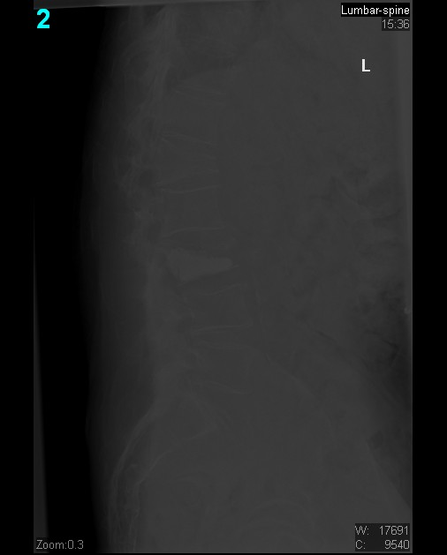
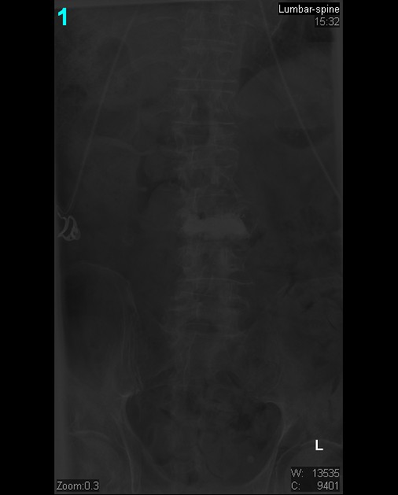
Case Study… X-ray in the ER after fall

Slide 3
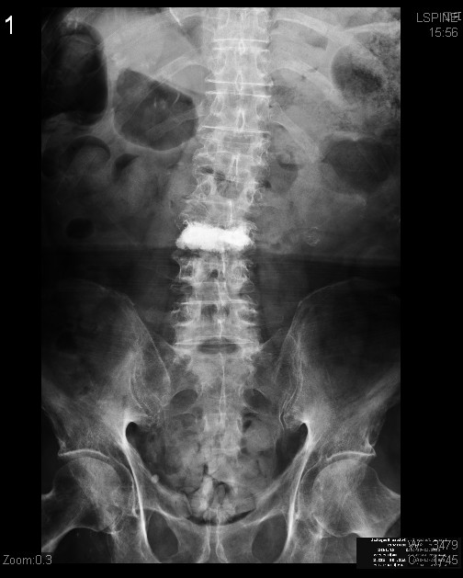
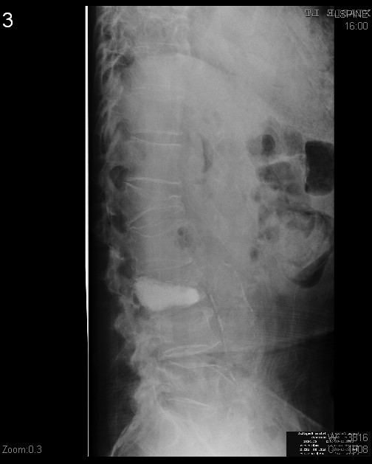
X ray in office after continuation pain x 4 weeks

Slide 4
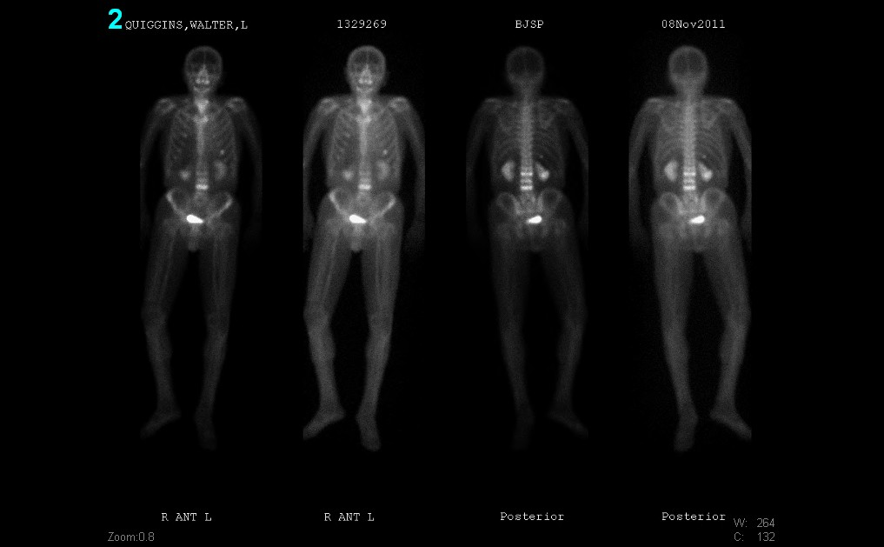
Follow up with advanced imaging

Slide 5
Office visit 4 weeks later
Initial x ray

Slide 6
Epidemiology of Vertebral Compression Fracture (VCF)
750,000 new vertebral fractures in the US (1)
25% of persons over 50 y/o will sustain a fracture in their lifetime (1)
Baby boomers are one of the fastest growing segments of our population
Approximately 2/3 of VCF go undiagnosed (2)
Treatment cost exceed 17 billion ((just below that of heart disease19 billion) 3)

Slide 7
Epidemiology continued
Obesity is protective against fractures (finally something that benefits horizontally gifted)
Risk factors include: advanced age, female gender, Caucasian, fall risk, recent fracture, multiple fractures in first degree relative, alcohol & tobacco use, early menopause, low body weight, decrease calcium or vitamin D

Slide 8
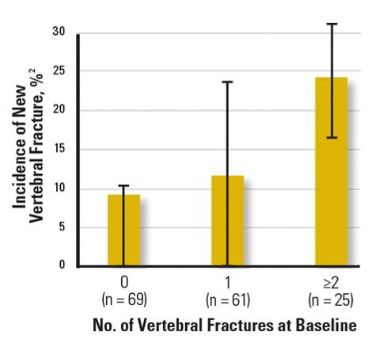
Increased Future Fracture Risk with Prior VCF
After first VCF, risk of a subsequent VCF is increased ¹
  5-fold after first VCF
  12-fold after > 2 VCFs
  75-fold after > 2 VCFs and low bone mass (below the 33rd percentile)
Ross PD, et al. Ann Intern Med. 1991;114:919-923.
Lindsay R, et al. JAMA Int. 2001;285(3):320-323.
Notes:
Increased Future Fracture Risk With Prior VCF
We know from multiple studies that a prior VCF is one of the most important predictors of future VCFs. For example, Ross (1991) and colleagues found that the lifetime risk of having a subsequent VCF increases 5-fold after the first VCF and 12-fold after 2 or more VCFs.
In addition, it was found that there is, on average, a 20% or 1 in 5 chance of a new fracture in the year after an incident fracture, with a greater likelihood with multiple prevalent fractures.
This increased fracture risk may be explained by biomechanical principles related to the degree of spinal deformity.¹⁴ In other words, as vertebral deformity progresses, the higher the relative risk of future fracture.

Slide 9
A Randomized Trial of Vertebroplasty for Osteoporotic Spinal Fractures
1813 patients screened, 1682 patients excluded
Trial designed for 250 patients, but only 131 enrolled
68 patients – vertebroplasty, 63 – SHAM
Patients included with fractures up to 12 months old,
neither MRI nor bone scan required
43 of 67 patients (64%) in vertebroplasty group and
29 of 61 patients (48%) in SHAM group reported pain relief (P=0.06)
27 of 32 patients (84%) in SHAM group without pain relief crossed over to vertebroplasty group at 1 month
Kallmes et. al., N Engl J Med, 2009

Slide 10
A Randomized Trial of Vertebroplasty for Painful Osteoporotic Vertebral Fractures
78 of 219 eligible patients enrolled
38 patients – vertebroplasty, 40 – SHAM
Multicenter (4) trial, but 67% treated at one site by one doctor
53 patients (68%) fractures > 6 weeks old (up to 12 months)
Baseline VAS pain scores: 4.5 +/- 2.3
Only 3 mL cement injected using single needle
31 of 38 patients (84%) in vertebroplasty arm reported either no change in back pain or increased back pain after procedure
24 of 40 patients (60%) in SHAM arm reported either no change in back pain or increased back pain after procedure
Buchbinder et. al., N Engl J Med, 2009

Slide 11
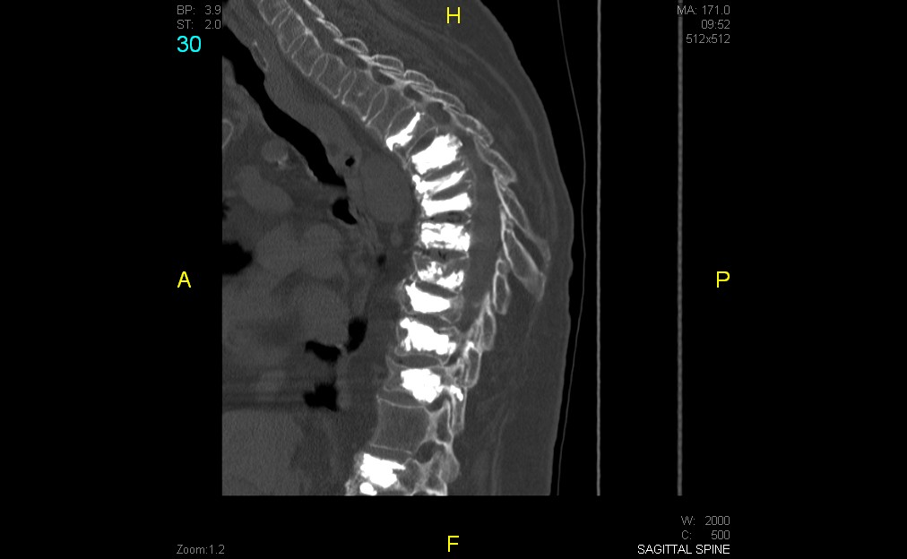
Identification of VCF’s

Slide 12
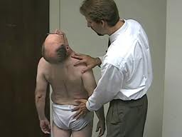
What is the correct way to identify a VCF?
History and physical exam are the most important. Also consider loss of height, increase kyphosis, protuberant belly, tenderness to palpation, pain when changing positions

Slide 13
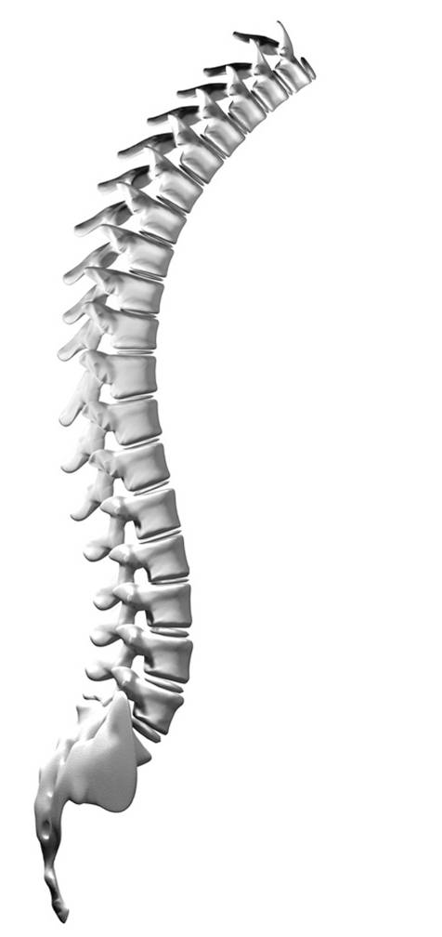
Location of Vertebral Fractures
Most common locations are midthoracic region (T7–T8) and thoracolumbar junction (T12–L1)
Stress is greatest at the apex of the curve when force is applied
Midthoracic region – thoracic kyphosis is most pronounced and loading during flexion is heightened
Thoracolumbar junction – the relatively rigid thoracic spine connects to the more freely mobile lumbar segments
T7-T8
T12-L1
Nevitt MC et al. Bone. 1999;25:613–619.
Cooper C et al. J Bone Min Res. 1992;7:221–227.
Notes:
When forces are applied to a model, the stress is greatest at the bend of the curve. When a model has compromised integrity, such as osteoporosis, the area prone to malfunction will most likely occur at the bend in the curve.
13

Slide 14
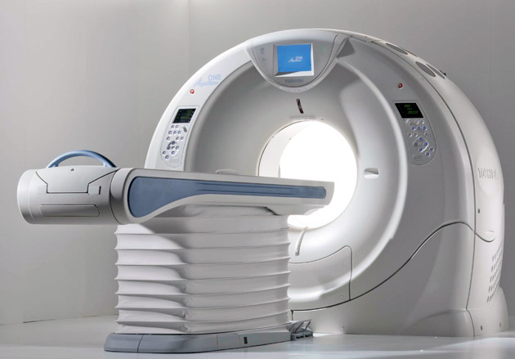
Identification
CT scan is used without contrast for visualization of fracture anatomy.
Can sometimes help with acuity if blood is still around the fracture site.
OK to use with pacemaker.
Commonly used with bone scan

Slide 15
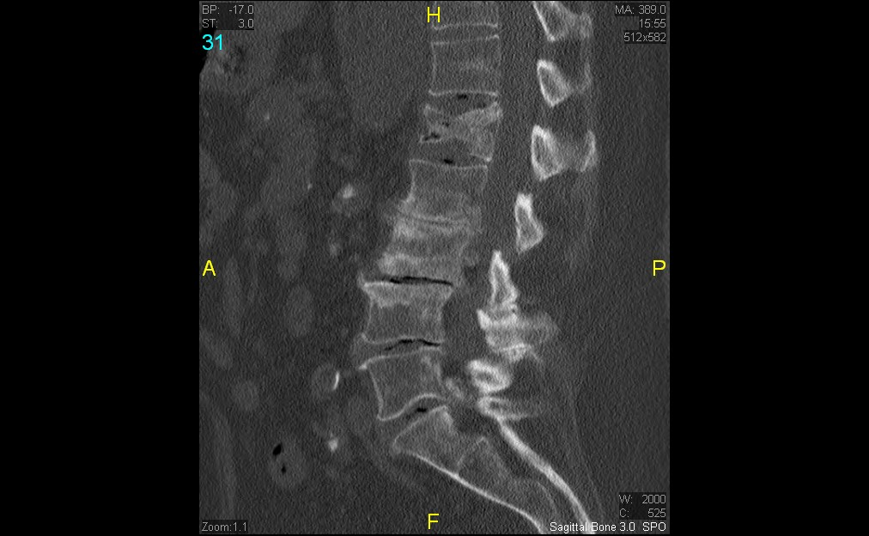
Sagittal cut of CT

Slide 16
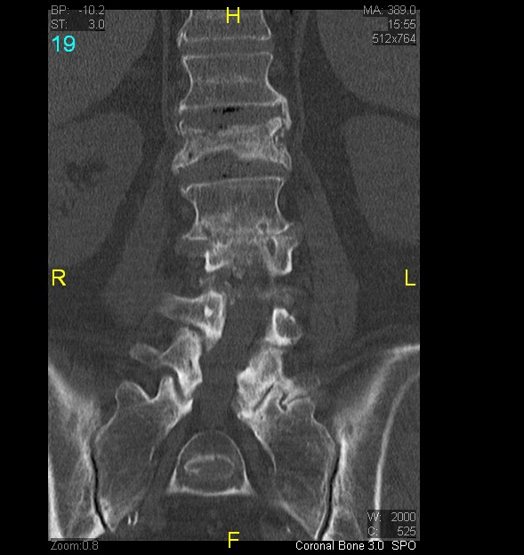
Coronal cut of CT

Slide 17
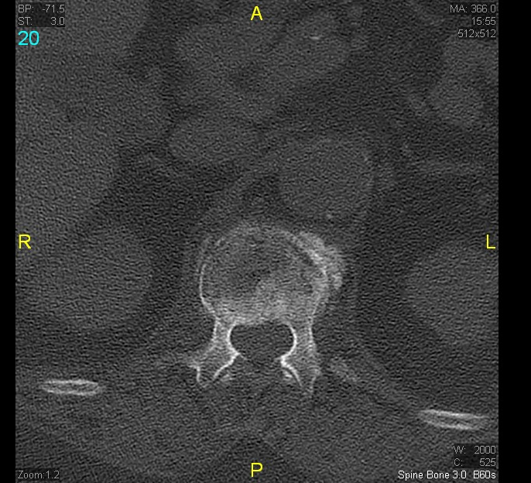
Axial cut of CT scan

Slide 18
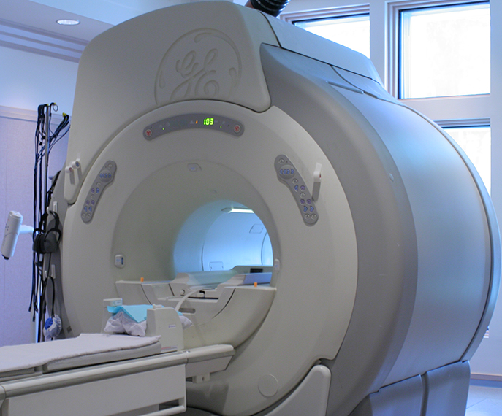
MRI
Can show acute fractures with bone marrow edema
Preferred if cord compression is suspected.
Takes longer
Claustrophobia
Cannot use with pacemakers at this time

Slide 19
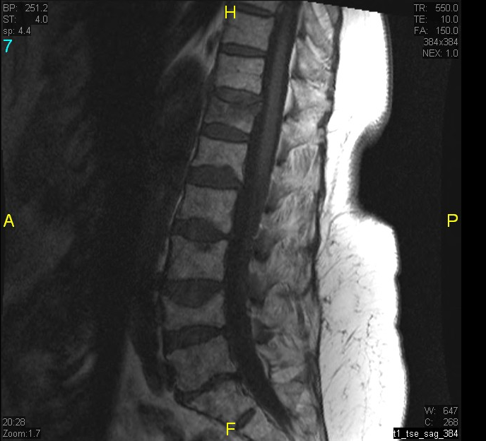
MRI T1

Slide 20
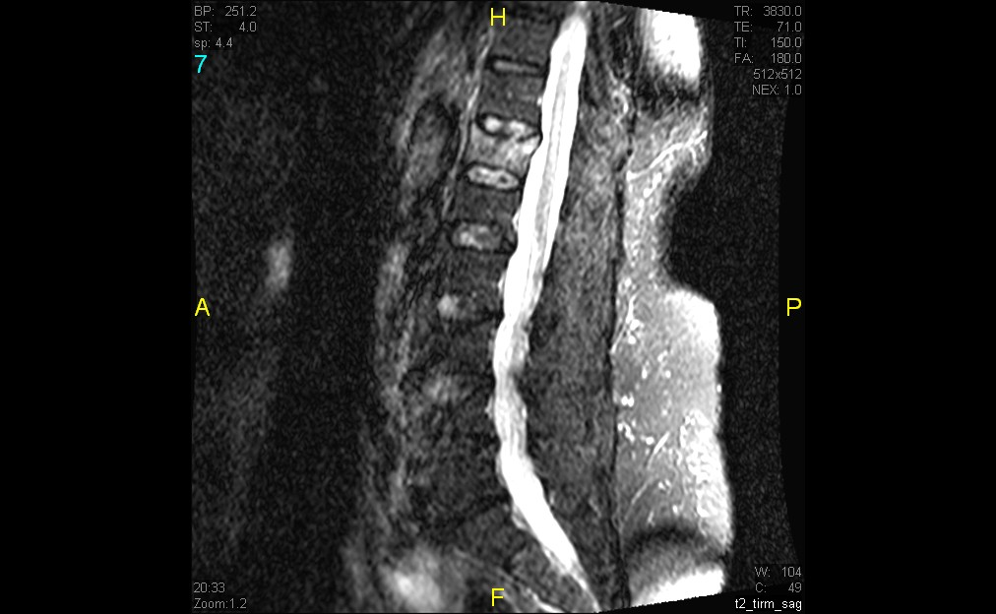
MRI STIR (Short Tau Inversion Recovery)
Notice edema
Acute fracture
No edema
Chronic fracture

Slide 21
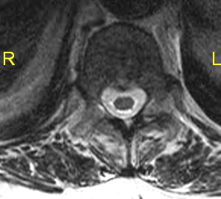
Axial cut MRI

Slide 22
MRI
CT

Slide 23
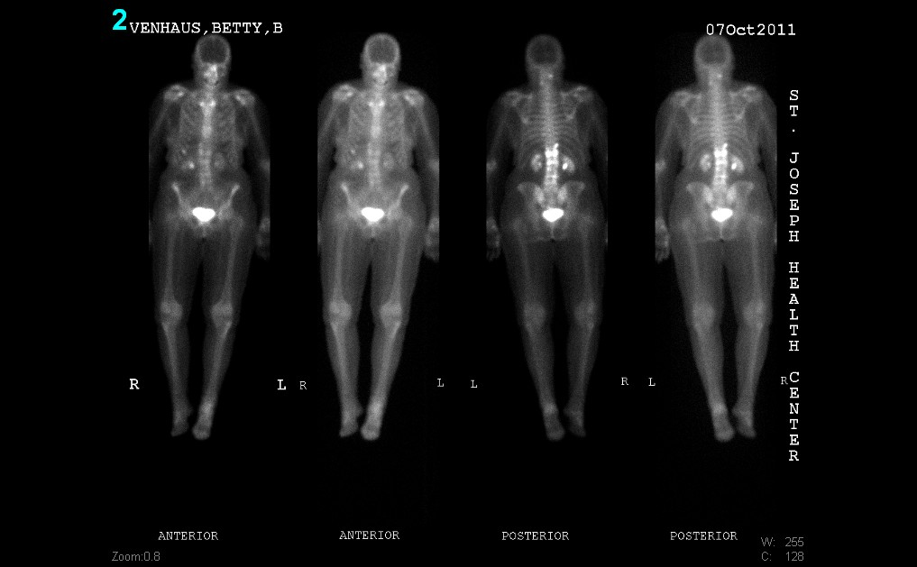
Use of bone scan imaging can be helpful to evaluate a large area at one sitting. However, the fracture must be at least 72 hours old to be detected. Generally is used with x ray or CT. Not a good stand alone test. Can be tolerated by the most claustrophobic patient.

Slide 24
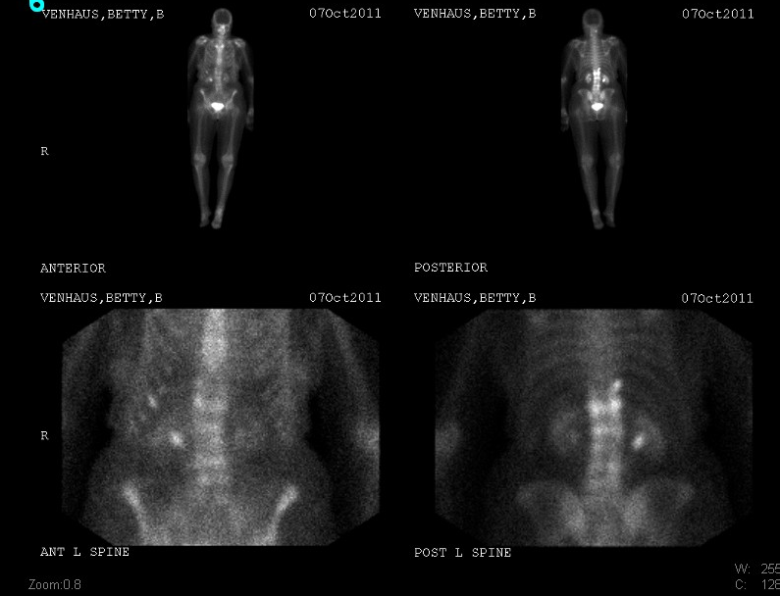
Bone Scan cone down
xxxxxxxx
xxxxxxxxx
xxxxxxxx
xxxxxxxx

Slide 25
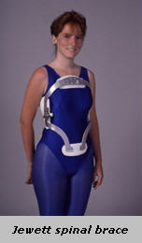
Management of VCF
Treatment for VCF include: rest, oral analgesia, Miacalcin nasal spray, braces, therapy, and Kyphoplasty (super glue).

Slide 26
Treatment guidelines American Academy of Orthopedic Surgeons
Bed rest, analgesia, and alternative medicine were deemed inconclusive
Bracing for compression fracture deemed inconclusive
Exercise program in acute fracture deemed inconclusive
The only recommendation that has a moderate degree of strength by AAOS is the use of Miacalcin
The use of Kyphoplasty was recommended with a weak degree of strength

Slide 27
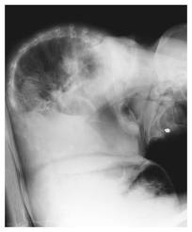
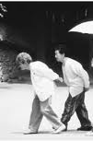
This is a typical compression fracture patient

Slide 28
Our typical compression fracture
Brace company compression fracture

Slide 29
Complications of “Conservative” Management
Bed rest and narcotics leads to rapid and often irreversible functional decline in elderly patients
Loss of bone density – 2% week
Loss of muscle strength – 10% week
Increased incidence of pressure sores
Increased heart rate and decreased coronary flow
Increased incidence of DVT and PE
Increased incidence of constipation and fecal impaction

Slide 30
Rationale for Surgical Management of Acute Vertebral Compression Fractures
Rapid resolution of pain allowing for early return to baseline functioning and mobility
Avoidance of complications associated with conservative management

Slide 31
VCF Progression
T-12 Vertebral Compression fracture treated “conservatively”
January 2003
February 2003
May 2003
MRI images of progressive morphometric changes in the presence of a vertebral compression fracture at T-12 (the thoracolumbar junction).
Courtesy of Michael Hisey, M.D., Texas Back Institute.
Notes:
VCFs can rapidly progress. In this example, you can see a noticeable vertebral body collapse in just one month, with a much more severe situation in only four months.

Slide 32
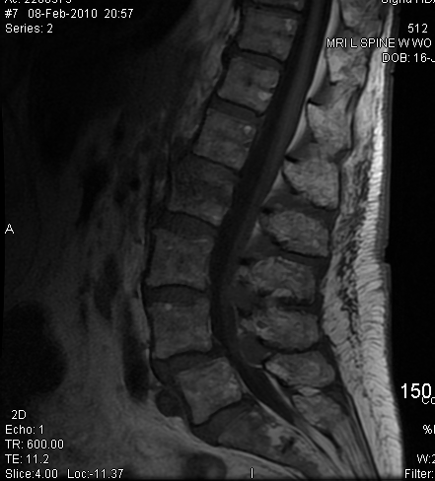
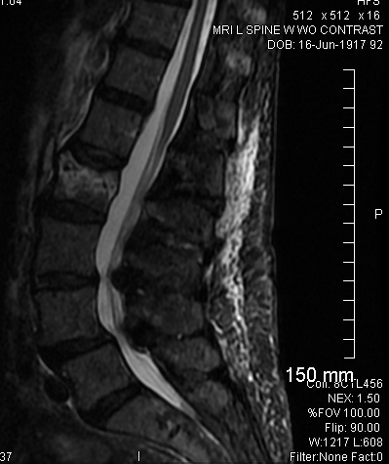
92 year old woman case study

Slide 33
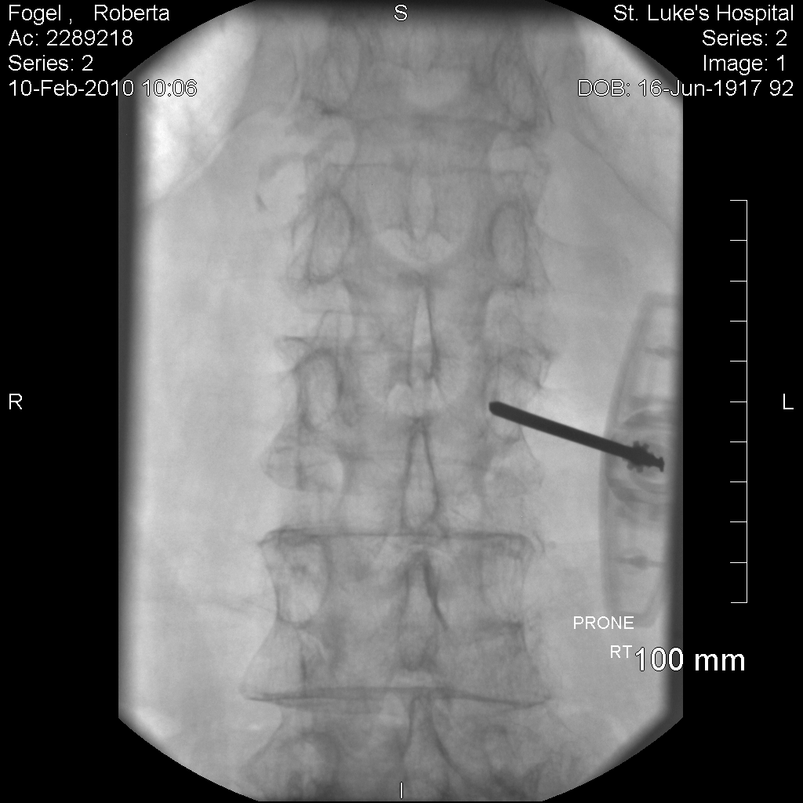
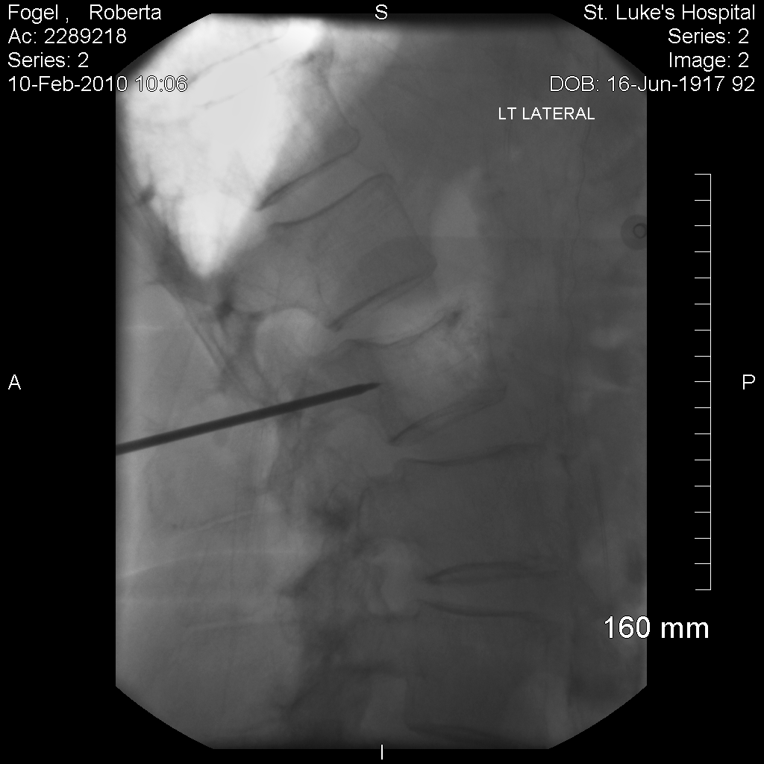
Acute L2 vertebral compression fracture (VCF)

Slide 34
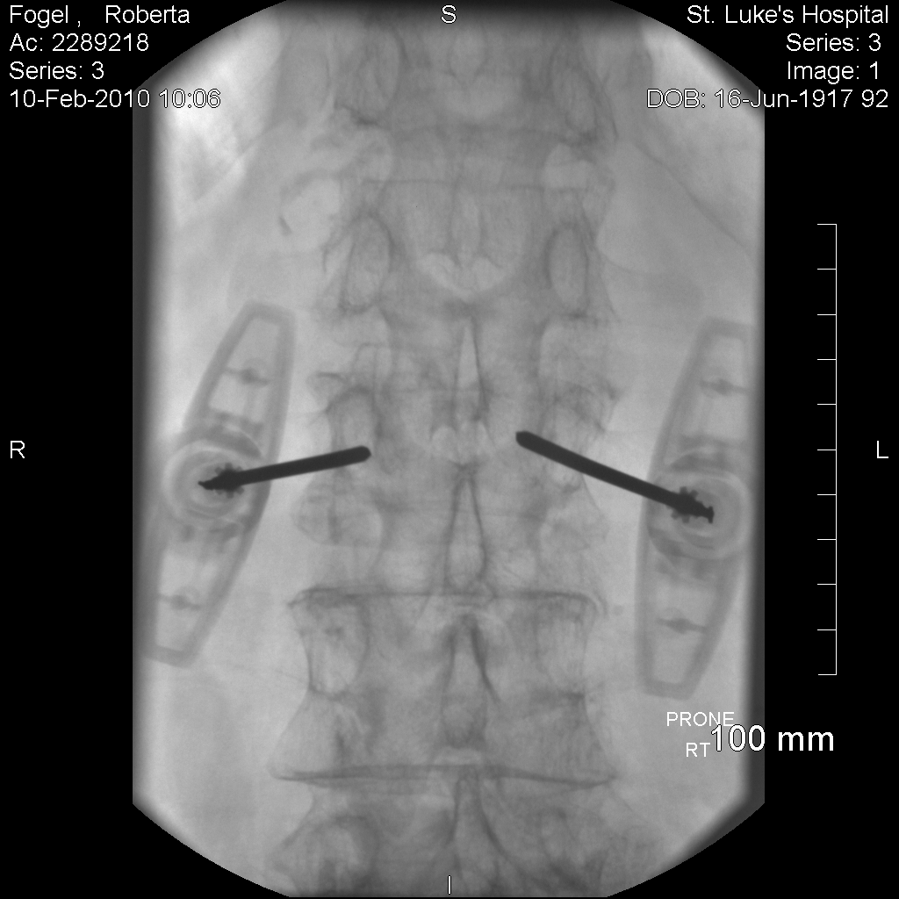
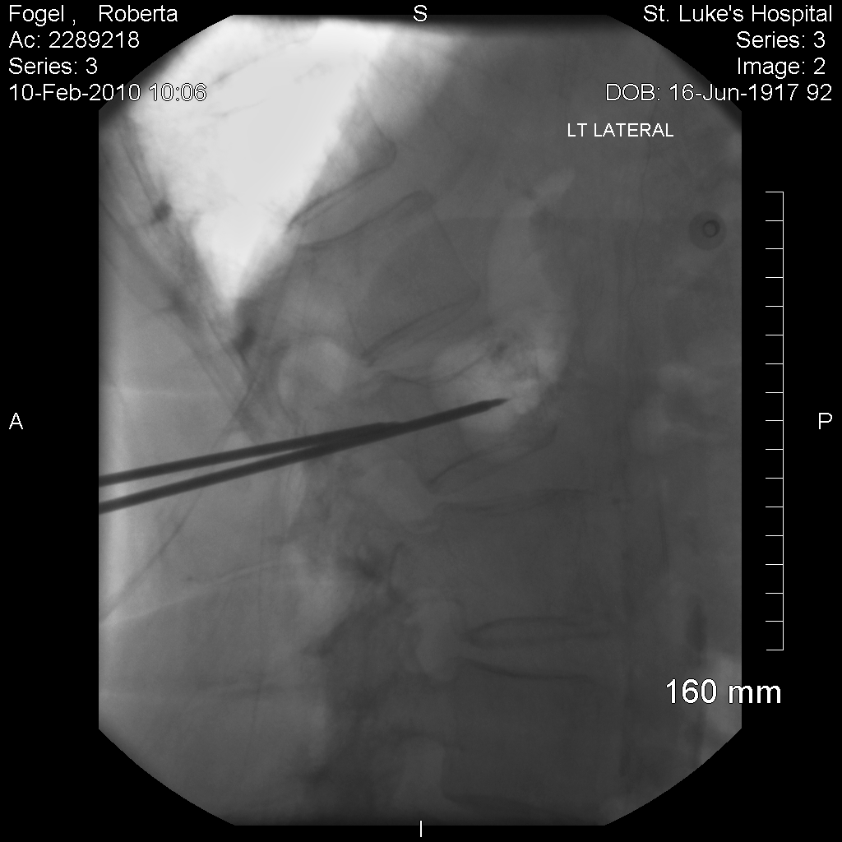
Bilateral transpedicular - 13 gauge needles

Slide 35
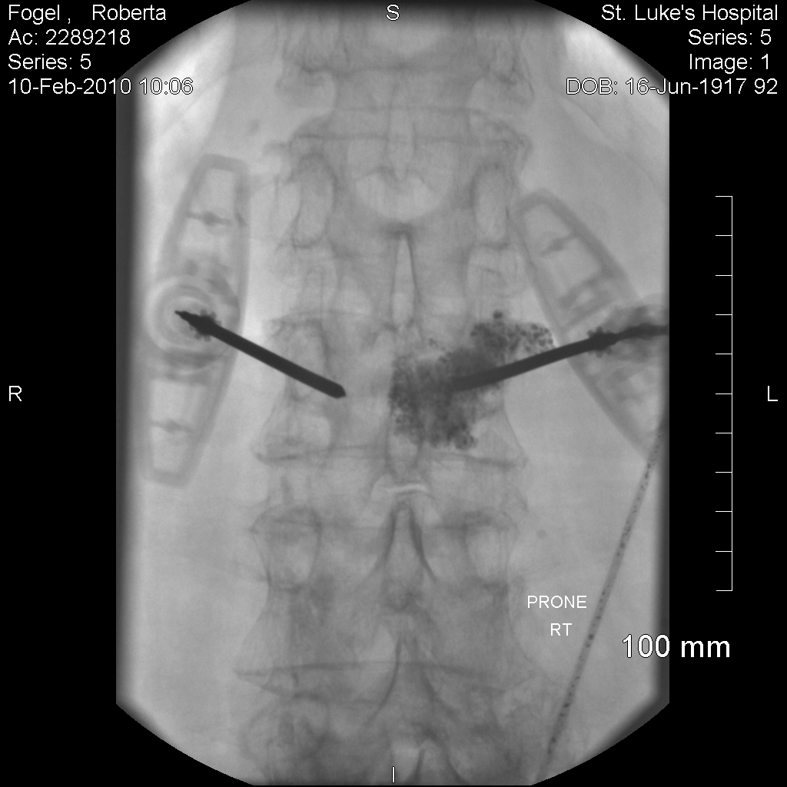

Right guide needle cement injection

Slide 36
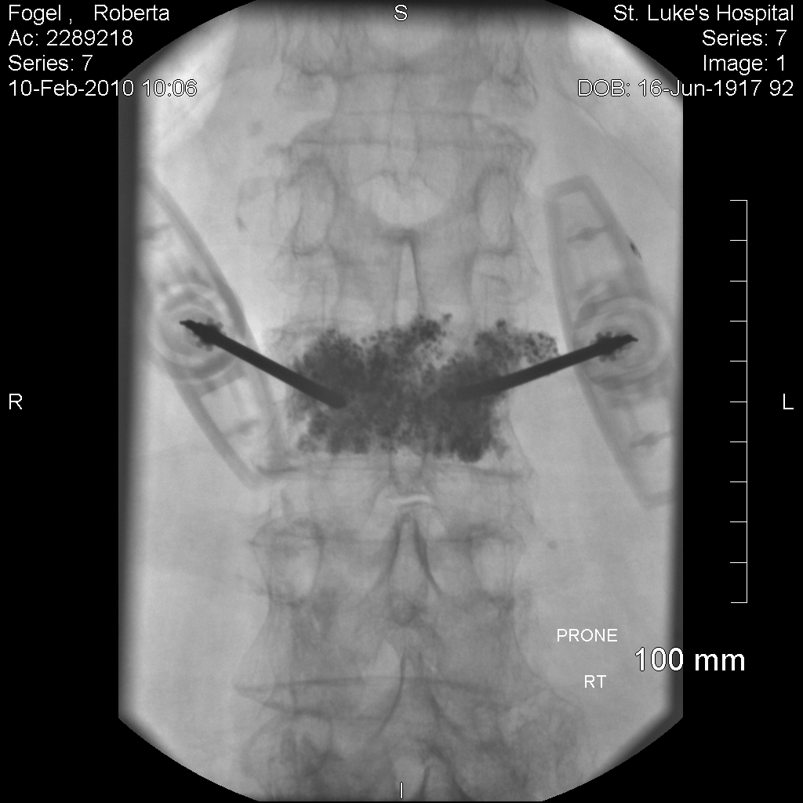
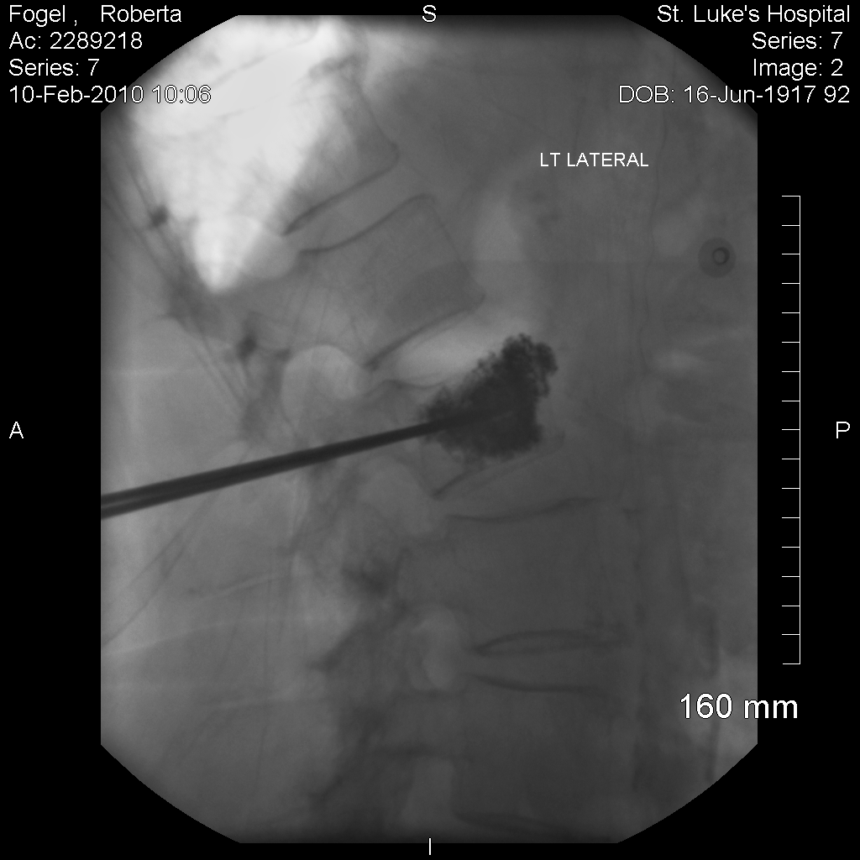
Left guide needle cement injection

Slide 37
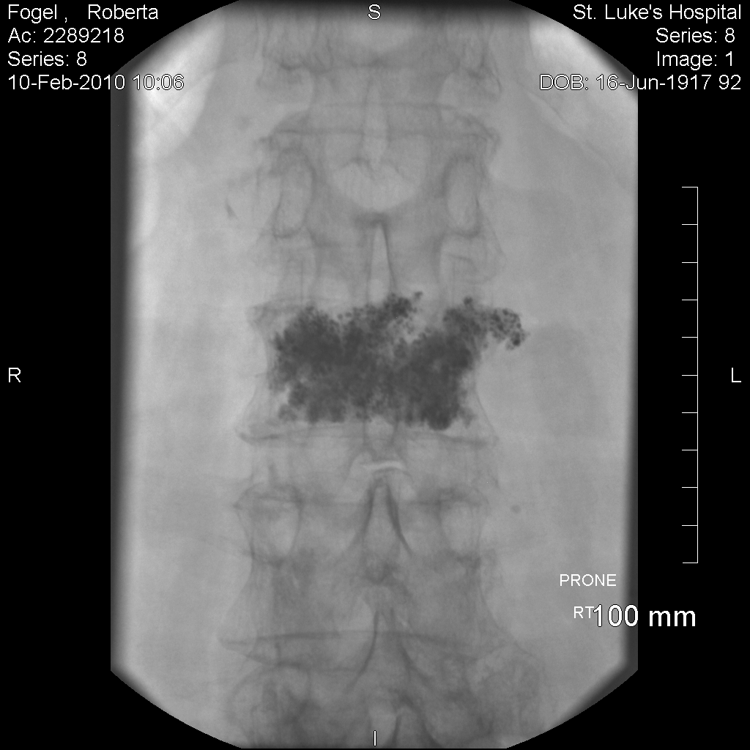
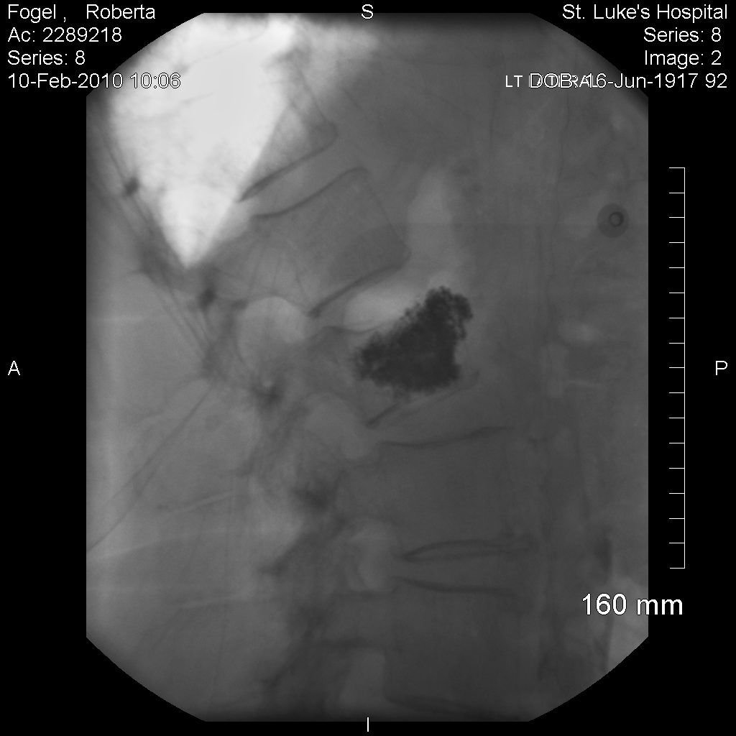
7 mL cement

Slide 38
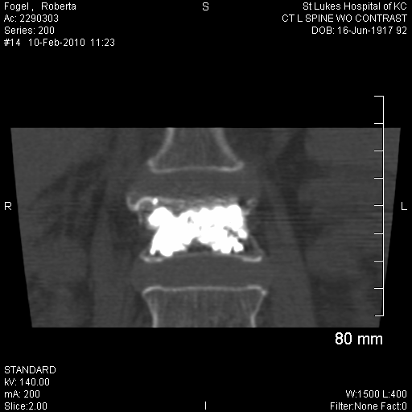
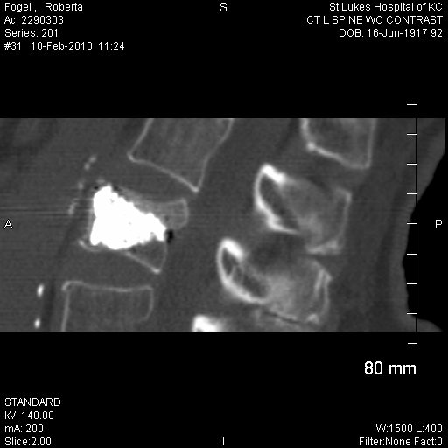
7 mL cement CT scan

Slide 39
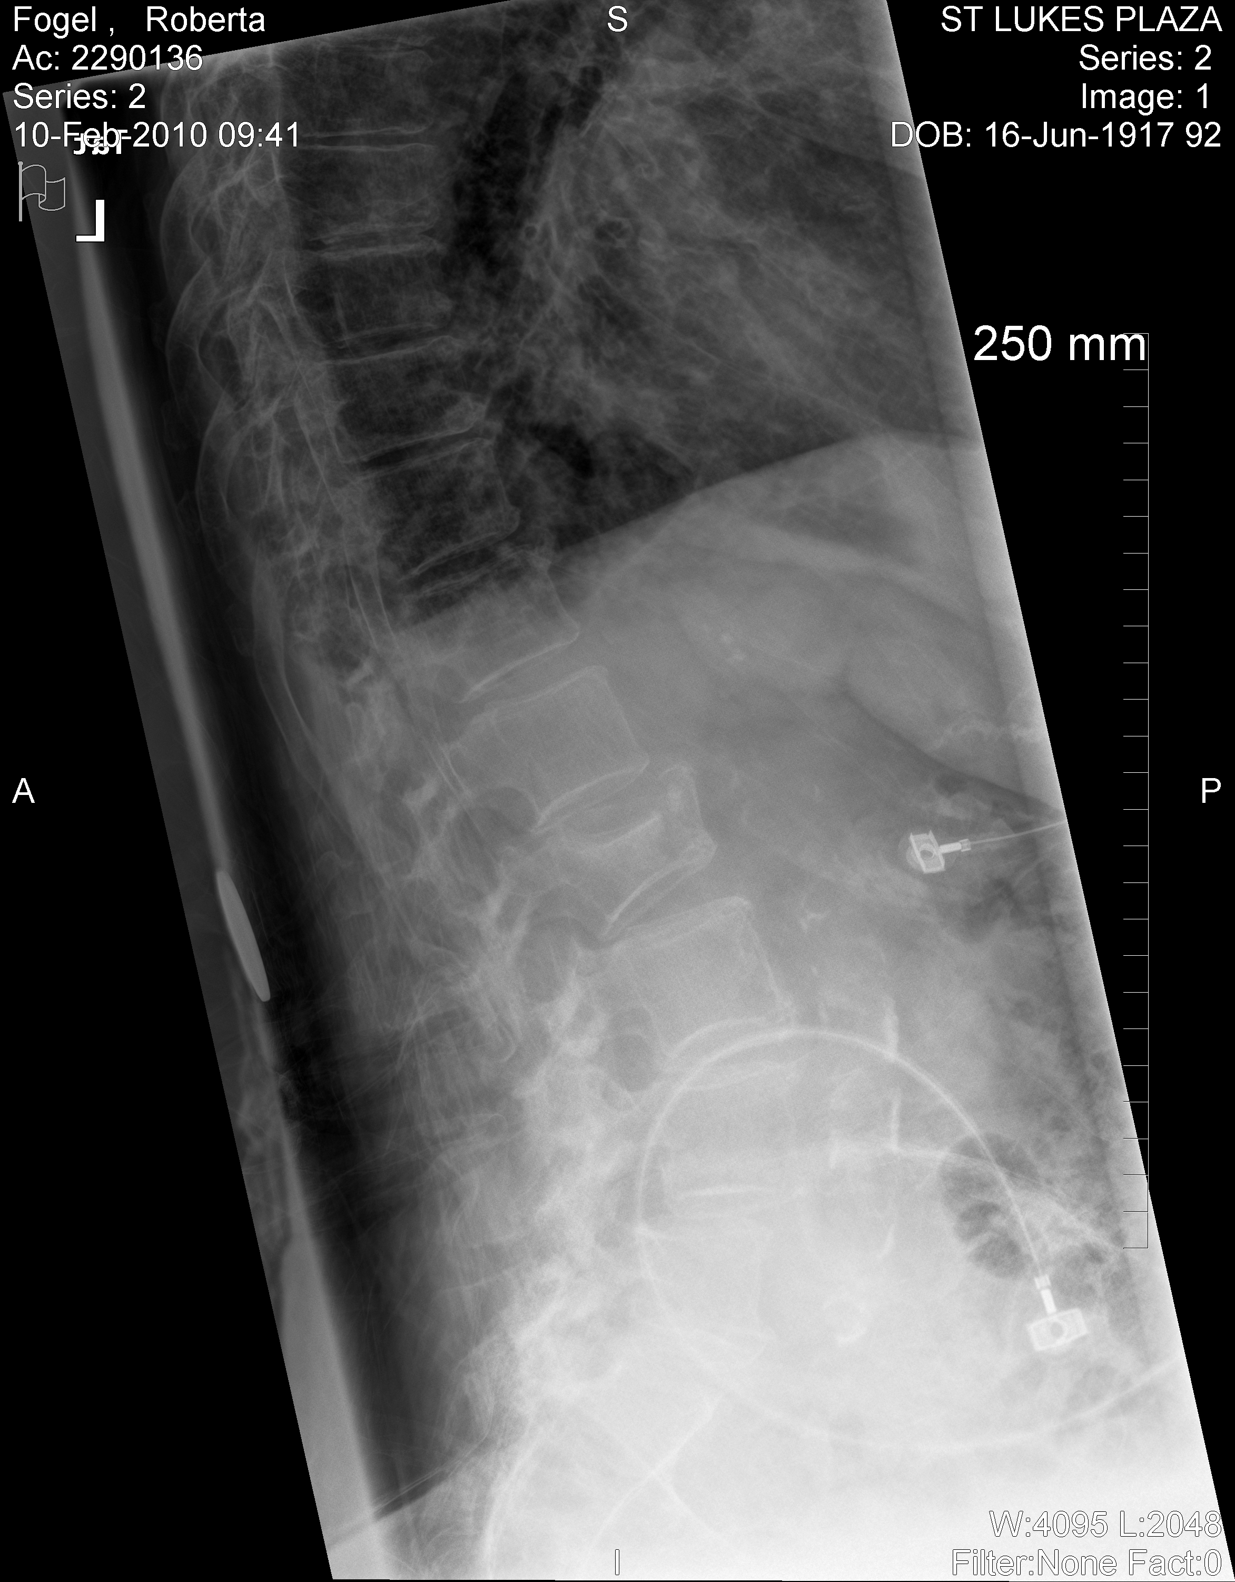
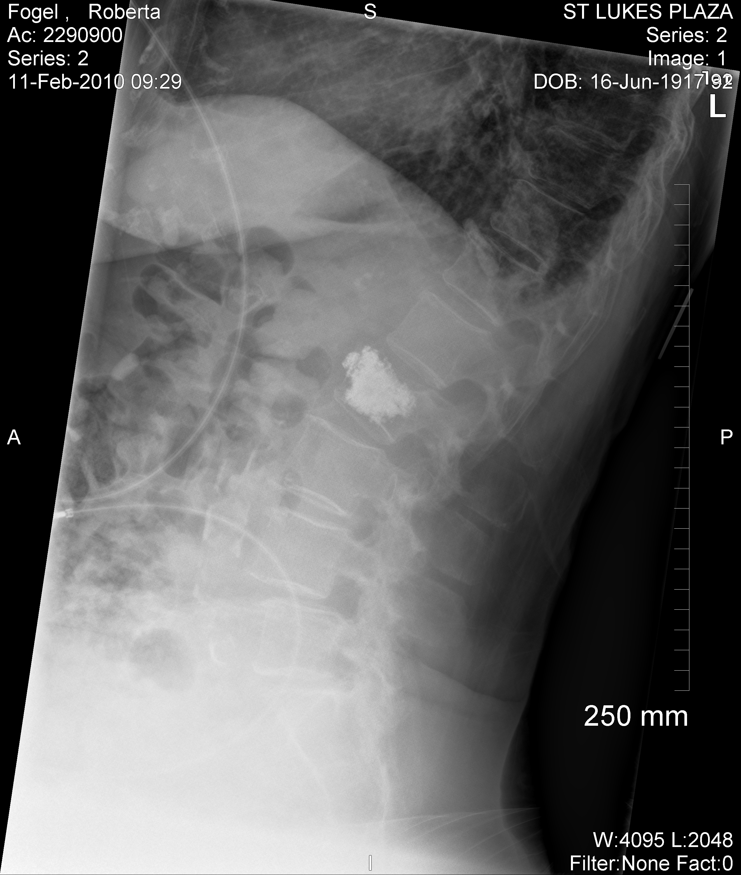
92 year old woman
Before & after L2 Vertebroplasty

Slide 40
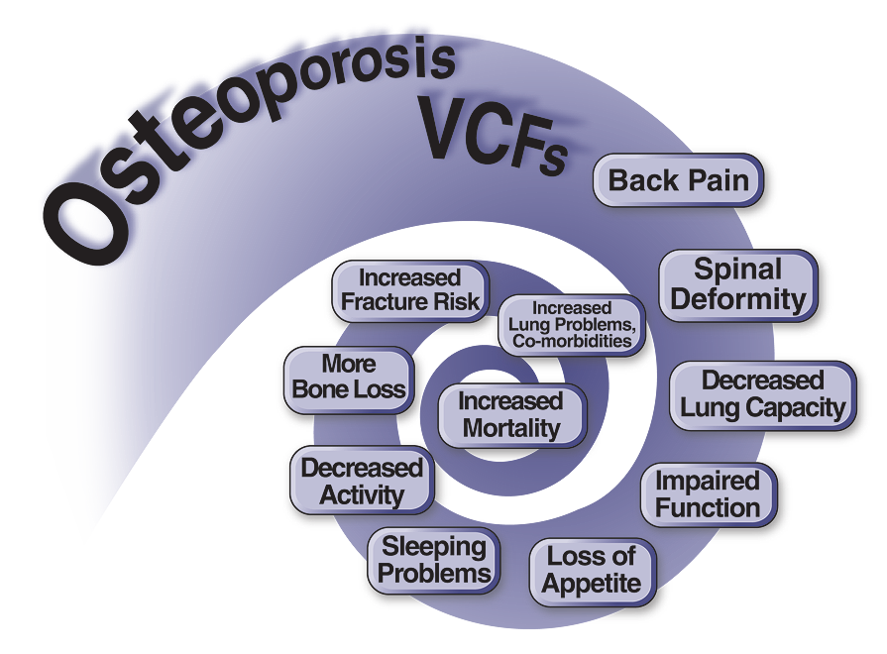
Downward Spiral of VCFs
Notes:
Ignoring vertebral fracture causes a vicious downward spiral of physical, social, and psychological consequences, resulting in increased mortality for those afflicted.

Slide 41
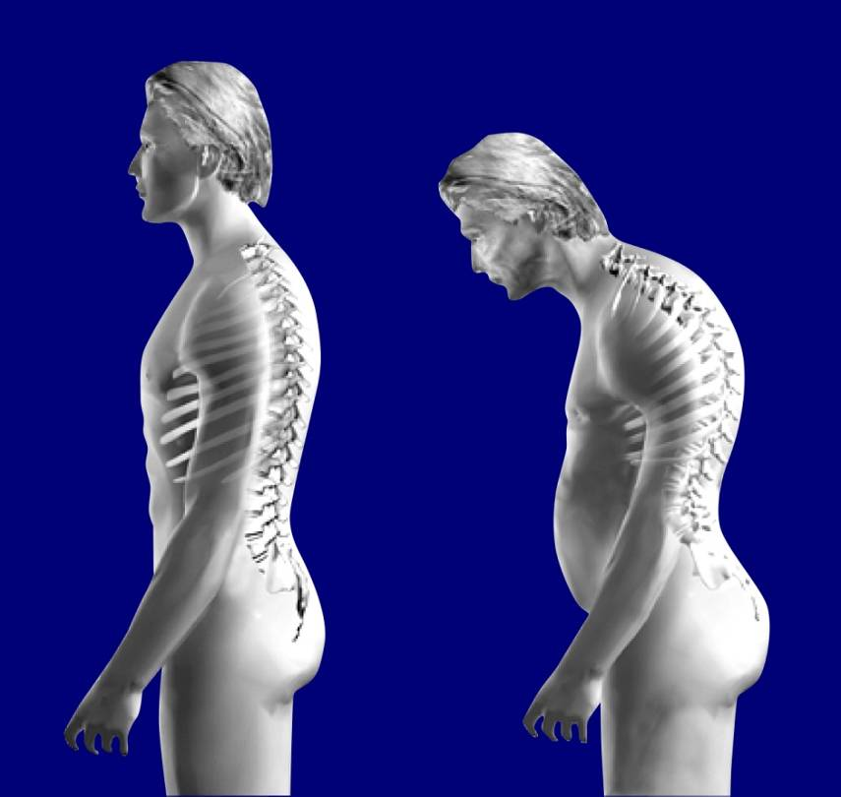
Impact of Deformity due to VCFs
Chronic, debilitating pain¹⁻⁴
Decreased lung function (VC, FEV1)⁴⁻⁶
Impaired physical function^{1,4,7-9}
Impaired gait or poor balance^{2,10,11}
Early satiety, gastric distress¹
Sleep disorders¹
Decreased Activities of Daily Living (ADL)^{1,2,9}
Increased dependence on family members and friends²
Clinical anxiety and/or depression^{1,2}
Future fracture risk¹²⁻¹⁶
Increased mortality¹⁷⁻¹⁸
Normal
Kyphotic
1) Silverman 1992. 2) Gold 1996. 3) Nevitt 1998. 4) Plujim 2000. 5) Leech 1990. 6) Schlaich 1998.
7) Lyles 1993. 8) Greendale 2000. 9) Silverman 2001. 10) Gold 2004. 11) Sinaki 2004. 12) Ross 1991.
13) Ross 1993. 14) Lindsay 2001. 15) Lunt 2003. 16) Lindsay 2005. 17) Kado 1999. 18) Kado 2003.
Notes:
Osteoporotic fractures resulting from kyphosis are not just a vanity issue. Severe health issues magnify in the setting of the vertebral height loss.
References:
Silverman S. The clinical consequences of vertebral compression fracture. Bone 1992;13:S27-S31.
Gold D. The clinical impact of vertebral fractures: quality of life in women with osteoporosis. Bone 1996;18(3):185S-9S.
Nevitt MC, Ettinger B, Black DM, et al. The association of radiographically detected vertebral fractures with back pain and function: a prospective study. Ann Intern Med 1998;128(10):793-800.
Pluijm S, Tromp A, Smit J, Deeg D, Lips P. Consequences of vertebral deformities in older men and women. J Bone Miner Res 2000;15(8):1564-72.
Leech JA, Dulberg C, Kellie S, Pattee L, Gay J. Relationship of lung function to severity of osteoporosis in women. Am Rev Resp Disease 1990;141(1):68-71.
Schlaich C, Minne H, Bruckner T, et al. Reduced pulmonary function in patients with spinal osteoporotic fractures. Osteoporos Int 1998;8:261-7.
Lyles KW, Gold DT, Shipp KM, Pieper CF, Martinez S, Mulhausen PL. Association of osteoporotic vertebral compression fractures with impaired functional status. Am J Med 1993;94(6):595-601.
Greendale G, DeAmicis T, Bucur A, et al. A Prospective Study of the Effect of Fracture on Measured Physical Performance: Results from the MacArthur Study - MAC. J Am Geriatr Soc 2000;48:546-9.
Silverman S, Minshall M, Shen W, Harper K, Xie S. The relationship of health-related quality of life to prevalent and incident vertebral fractures in postmenopausal women with osteoporosis. Arthritis Rheum 2001;44(11):2611-9.
Gold DT, Shipp KM, Pieper CF, Duncan PW, Martinez S, Lyles KW. Group treatment improves trunk strength and psychological status in older women with vertebral fractures: results of a randomized, clinical trial. J Am Geriatr Soc 2004;52(9):1471-8.
Sinaki M. Falls, fractures, and hip pads. Curr Osteoporos Rep 2004;2(4):131-7.
Ross PD, Davis JW, Epstein RS, Wasnich RD. Pre-existing fractures and bone mass predict vertebral fracture incidence in women. Ann Intern Med 1991;114(11):919-23.
Ross PD, Genant HK, Davis JW, Miller PD, Wasnich RD. Predicting vertebral fracture incidence from prevalent fractures and bone density among non-black, osteoporotic women. Osteoporos Int 1993;3(3):120-6.
Lindsay R, Silverman SL, Cooper C, et al. Risk of new vertebral fracture in the year following a fracture. Jama 2001;285(3):320-3.
Lunt M, O’Neill T, Felsenberg D, et al. Characteristics of a prevalent vertebral deformity predict subsequent vertebral fracture: results from the European Prospective Osteoporosis Study (EPOS). Bone 2003;33 L1:505-13.
Lindsay R, Pack S, Li Z. Longitudinal progression of fracture prevalence through a population of postmenopausal women with osteoporosis. Osteoporos Int 2005;16(3):306-12.
Kado D, Browner W, Palermo L, Nevitt M, Genant H, Cummings S. Vertebral Fractures and Mortality in Older Women. Arch Intern Med 1999;159:1215-20.
Kado DM, Duong T, Stone KL, et al. Incident vertebral fractures and mortality in older women: a prospective study. Osteoporos Int 2003;14(7):589-94.
41

Slide 42
Summary
Osteoporosis affects a significant proportion of the global population, particularly postmenopausal women
Vertebral compression fractures (VCFs) are a common result of poor bone quality due to osteoporosis, steroids, and cancer – yet most are not brought to clinical attention
VCFs cause many detrimental health consequences independent of pain that are associated with the resulting spinal deformity (downward spiral: physical, social, psychological)
VCFs significantly increase mortality rate, specifically pulmonary morbidity
Notes:
Why are we so content to leave spinal compression fractures un repaired?
Despite the considerable pain and disability associated with vertebral fractures, the majority are not brought to clinical attention.
Each vertebral fracture increases the risk of subsequent fracture, initiating a downward spiral of physical, social, and psychological consequences: pain, height loss, kyphosis, social isolation, diminished self-esteem, and depression are among the recognized consequences of vertebral fracture.
42

Slide 43
Summary (cont.)
Diagnose VCFs as early as possible to prevent further progression of spinal deformity and the associated consequences
Non-surgical management does not treat the resulting deformity from VCFs
Patients with recent VCFs with axial pain, tenderness that lessens with recumbency, and abnormal MRI could benefit from minimally-invasive surgical intervention such vertebroplasty or balloon kyphoplasty
Balloon kyphoplasty can provide fracture stabilization and the potential correction of spinal deformity
Notes:
43

Slide 44

Thank You

